Slide 1

^{深度学习研读会}
许勤昆

Slide 2


^{Contents}
1. Technical Details of Continuous Variables
^{2. Information Theory}
3. Structured Probabilistic Models

Slide 3
1.Technical Details of Continuous Variables
Q : What is the probability of randomly selecting a rational number from the interval [0,1]?

Slide 4
^{1.1 Measure}
In mathematical analysis, a measure on a set is a systematic way to assign a number to each suitable subset of that set, intuitively interpreted as its size.
In this sense, a measure is a generalization of the concepts of length, area, and volume.
A particularly important example is the Lebesgue measure on a Euclidean space, which assigns the conventional length, area, and volume of Euclidean geometry to suitable subsets of the n-dimensional Euclidean space R^{n}.
For instance, the Lebesgue measure of the interval [0, 1] in the real numbers is its length in the everyday sense of the word, specifically, 1.

Slide 5
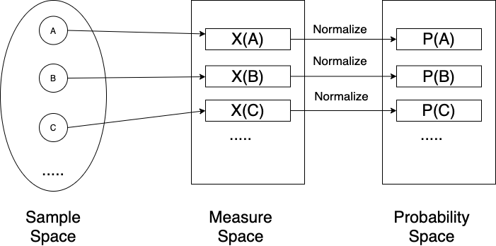
1.2 Relationship between probability and measure

Slide 6
^{1.3 Countable Set}
A set is countable if it is finite, or if it is infinite but you can give a map that matches up all of the natural numbers with all of the elements of this set.
That is, you can choose some element of your set to be 1st, and then some other element to be 2nd, etc., and eventually list everything in this fashion.

Slide 7
^{1.4 Rational number}
In mathematics, a rational number is a number that can be expressed as the quotient or fraction p/q of two integers, a numerator p and a non-zero denominator q.
How to list all the rational numbers?
Consider p + q = 2, 3, 4 …
[1/1], [2/1, 1/2], [2/2, 3/1, 1/3], …
Are all rational numbers listed?

Slide 8

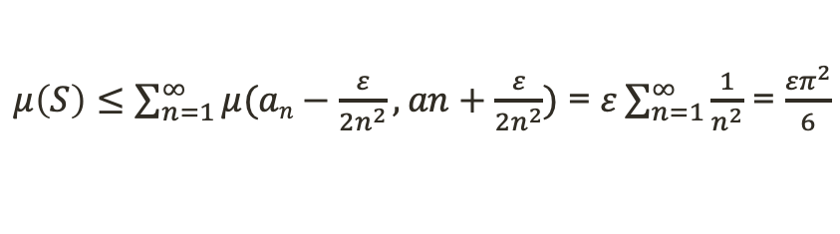

^{1.5 Measure of Countable Set}
Let C is a countable set, C = {a₁, a₂, a₃,…}
a₁ - ε/2n²
a₂ + ε/2n²
(
)
(
)
(
)
(
)
(
)
a₁
a₂
a₃
a₄
a₅
x
Now, at each point a_{n} “glue” on an interval of length ε/n², which is ε > 0 and ε is an arbitrary real number.
That is something like that (a_{n}- ε/2n², a_{n}+ε/2n²). Call the result set S.
$μ\left(S\right)≤\sum_{n=1}^{∞}{μ(an−\frac{ε}{2n^{2}}, an+\frac{ε}{2n^{2}})}$ = $ε\sum_{n=1}^{∞}{\frac{1}{n^{2}}}$ = $\frac{{επ}^{2}}{6}$
$μ\left(C\right)≤μ\left(S\right)≤\frac{{επ}^{2}}{6}$
$$As ε→0, μ\left(S\right)→0,μ\left(C\right)→0$$

Slide 9
^{1.6 Answer}
Q : What is the probability of randomly selecting a rational number from the interval [0,1]?
A : 0

Slide 10
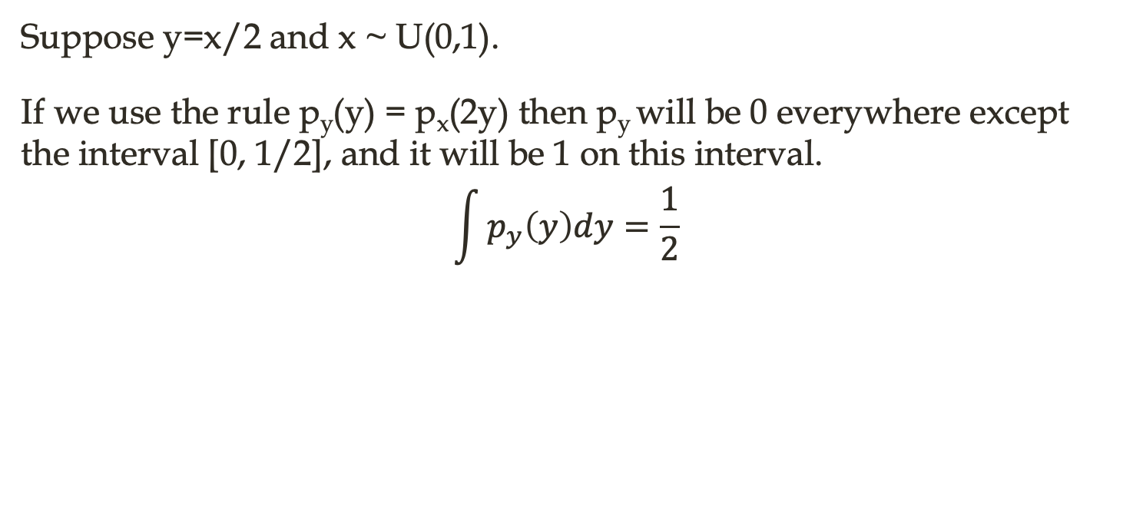
^{1.7 Application}
﻿Suppose we have two random variables, X and Y, such that Y = g(X)
The p.d.f of X is p_{x}(x), what is p_{y}(y)?
p_{y}(y) = px(g⁻¹(y)) ?
Suppose y=x/2 and x ~ U(0,1).
I﻿f we use the rule p_{y}(y) = p_{x}(2y) then p_{y} will be 0 everywhere except the interval [0, 1/2], and it will be 1 on this interval.
$$\int{p_{y}\left(y\right)dy}=\frac{1}{2}$$

Slide 11
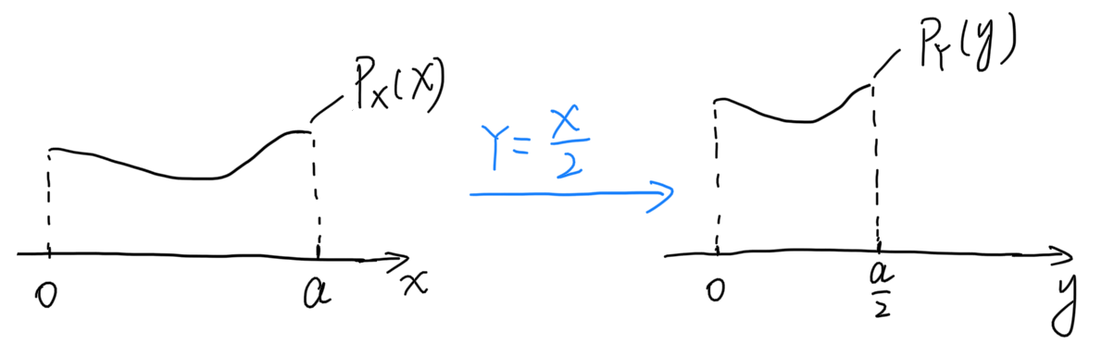
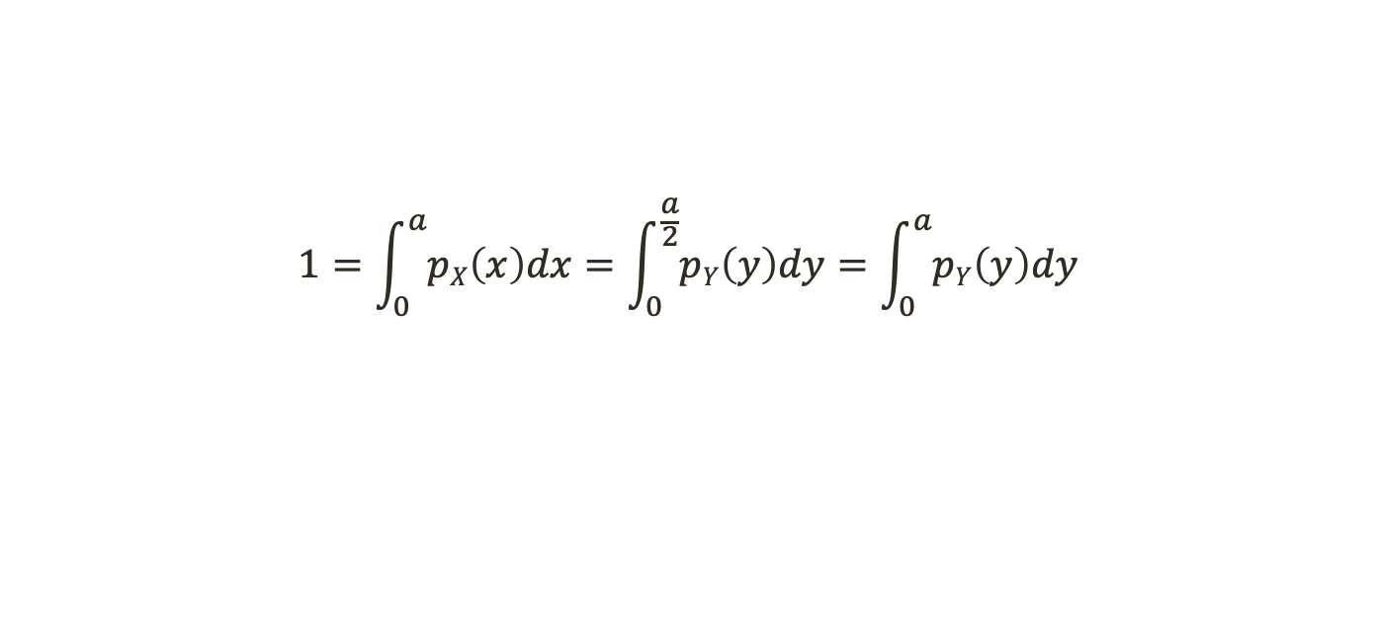


^{1.7 Application}
What’s wrong?
﻿Recall that the probability of x lying in an infinitesimally small region with volume δx is given by p(x)δx.
Since g can expand or contract space, the infinitesimal volume surrounding x in x space may have different volume in y space.
$$1=\int_{0}^{a}{pX\left(x\right)dx}=\int_{0}^{\frac{a}{2}}{pY\left(y\right)dy}=\int_{0}^{a}{pY\left(y\right)dy}$$
$$|pX\left(x\right)dx|=|pY\left(g(x)\right)dy|$$
$$pY\left(y\right)dy=px\left(g^{−1}\left(y\right)\right)|\frac{∂x}{∂y}|$$

Slide 12
^{2.Information Theory}
Information theory studies the quantification, storage, and communication of information.
It was originally proposed by Claude Shannon in 1948 to find fundamental limits on signal processing and communication operations such as data compression, in a landmark paper titled "A Mathematical Theory of Communication".
Abstractly, information can be thought of as the resolution of uncertainty.

Slide 13
^{2.1 Information}
Consider the following thought experiment. We have a friend with a deck of cards. He will shuffle the deck, flip over some cards, and tell us statements about the cards.
First, he flip over a card and tell us, “I see a card.”
Next, he flip over a card and say, “I see a heart.”
Next, he flip over a card and say, “This is the 33 of spades.”
Suppose that finally he flip over every card from the deck and read off the entire sequence of the shuffled deck. There are 52! different orders to the deck.
we may build off the idea that information represents the degree of surprise or the abstract possibility of the event.

Slide 14
^{2.2 Self-Information}
Axioms:
An event with probability 100% is perfectly unsurprising and yields no information.
The less probable an event is, the more surprising it is and the more information it yields.
If two independent events are measured separately, the total amount of information is the sum of the self-informations of the individual events.
Broadly given an event x with probability P(x), the information content is defined as follows:
I(x) = -log_{b}P(x)
When b=2, units called bits or shannons; b = e, units called nats.

Slide 15
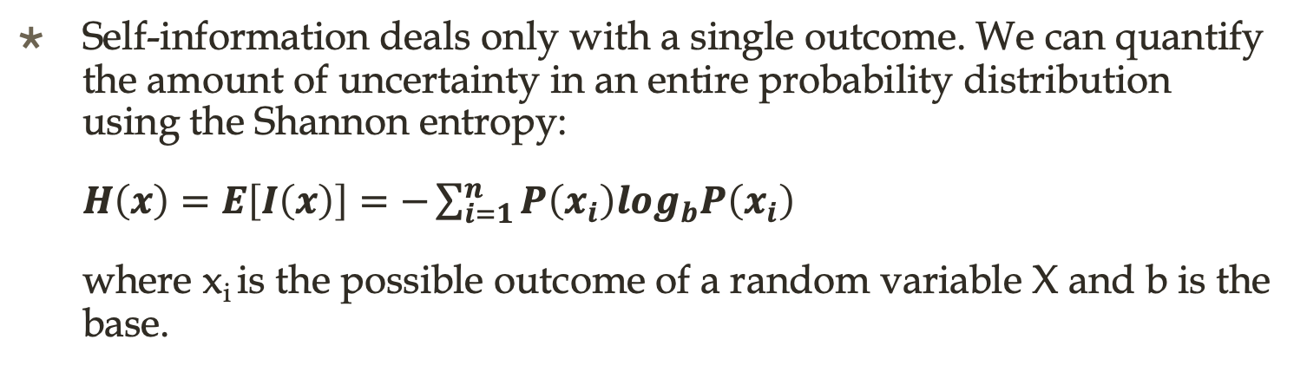
2.3 Shannon Entropy(Information Entropy)
In information theory, the entropy of a random variable is the average level of "information", "surprise", or "uncertainty" inherent in the variable's possible outcomes.
Self-information deals only with a single outcome. We can quantify the amount of uncertainty in an entire probability distribution using the Shannon entropy:
$H\left(x\right)=E\left[I\left(x\right)\right]=−\sum_{i=1}^{n}{P\left(x_{i}\right)log_{b}P\left(x_{i}\right)}$
where x_{i} is the possible outcome of a random variable X and b is the base.

Slide 16
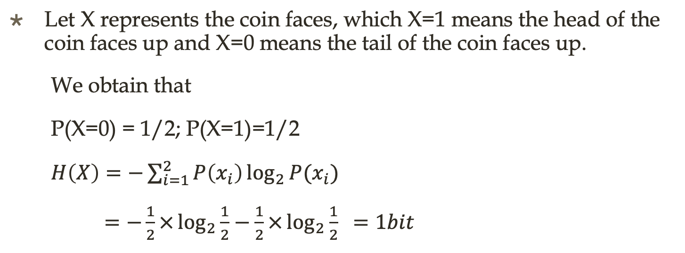
^{2.4 Practice-A}
Consider the example of a coin toss. The probability of heads is the same as the probability of tails, which is 1/2. Calculate the entropy of the coin toss.
Let X represents the coin faces, which X=1 means the head of the coin faces up and X=0 means the tail of the coin faces up.
We obtain that
P(X=0) = 1/2; P(X=1)=1/2
$H\left(X\right)=−\sum_{i=1}^{2}{P\left(x_{i}\right)\log_{2}{P(x_{i})}}$
$=−\frac{1}{2}×\log_{2}{\frac{1}{2}}−\frac{1}{2}×\log_{2}{\frac{1}{2} }=1bit$

Slide 17
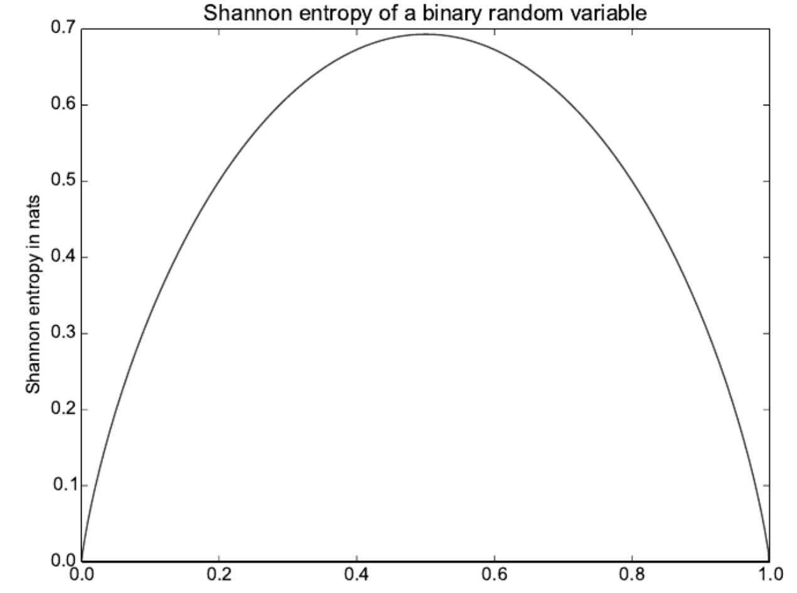
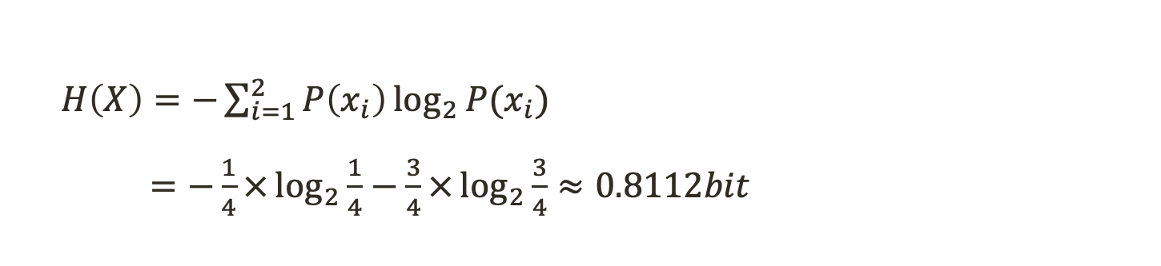
^{2.4 Practice-B}
What if the probability of heads is not same as the probability of tails?
Such as P(X=0) = 1/4 , and P(X=1)=3/4.
$H\left(X\right)=−\sum_{i=1}^{2}{P\left(x_{i}\right)\log_{2}{P(x_{i})}}$
$=−\frac{1}{4}×\log_{2}{\frac{1}{4}}−\frac{3}{4}×\log_{2}{\frac{3}{4}}≈0.8112bit$

Slide 18
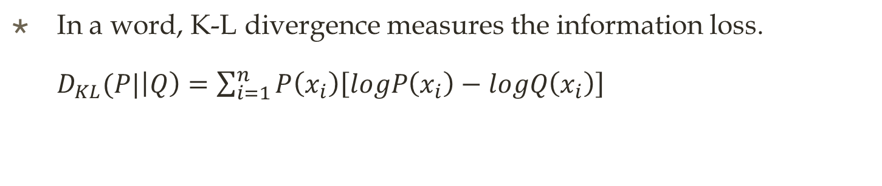
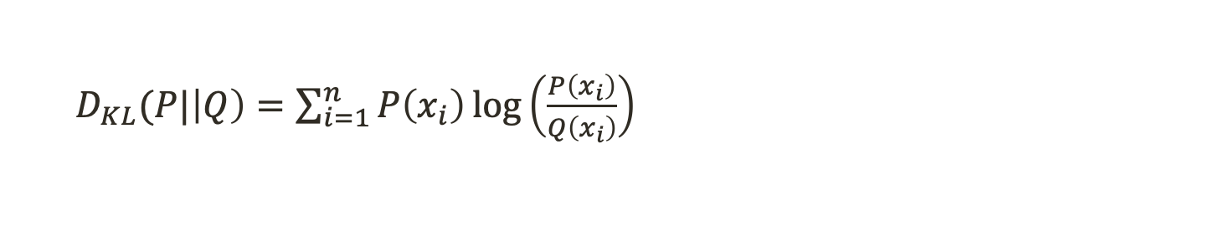
2.5 Kullback-Leibler (KL) divergence
If we have two separate probability distributions P (X) and Q(X) over the same random variable X, we can measure how different these two distributions are using the Kullback-Leibler (KL) divergence (also called relative entropy).
$D_{KL}(P|\left|Q\right)=\sum_{i=1}^{n}{P\left(x_{i}\right)\log\left(\frac{P\left(x_{i}\right)}{Q\left(x_{i}\right)}\right)}$
In a word, K-L divergence measures the information loss.
$D_{KL}(P|\left|Q\right)=\sum_{i=1}^{n}{P\left(x_{i}\right)\left[logP\left(x_{i}\right)−logQ\left(x_{i}\right)\right]}$

Slide 19
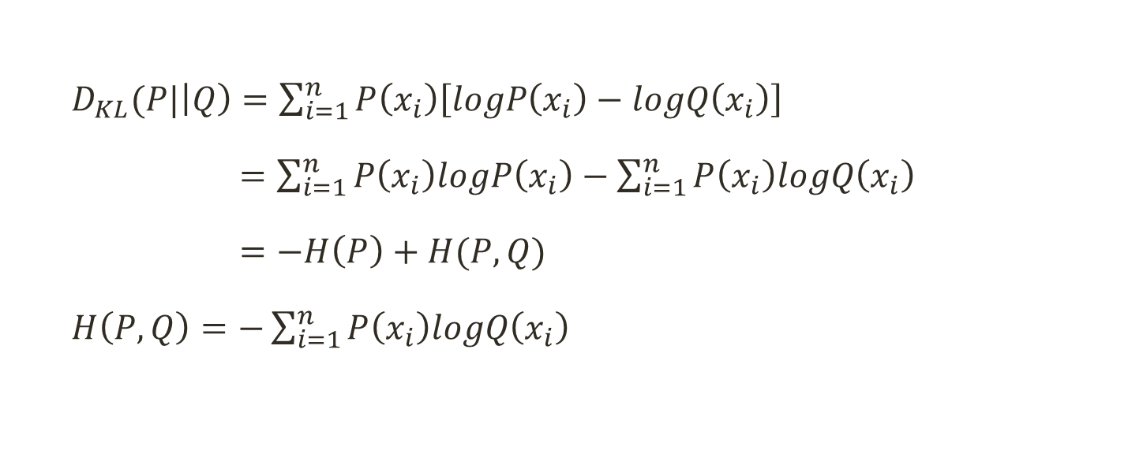
^{2.6 Cross-Entropy}
$D_{KL}(P|\left|Q\right)=\sum_{i=1}^{n}{P\left(x_{i}\right)\left[logP\left(x_{i}\right)−logQ\left(x_{i}\right)\right]}$
$=\sum_{i=1}^{n}{P\left(x_{i}\right)logP\left(x_{i}\right)}−\sum_{i=1}^{n}{P\left(x_{i}\right)logQ\left(x_{i}\right)}$
$=−H\left(P\right)+H(P, Q)$
$H\left(P,Q\right)=−\sum_{i=1}^{n}{P\left(x_{i}\right)logQ\left(x_{i}\right)}$

Slide 20
3.1 The Challenge Of Unstructured Models
The goal of deep learning is to predict the input by training a probability model.
However, Modeling a rich distribution over thousands or millions of random variables is a challenging task, both computationally and statistically.
For a small, 32 × 32 pixel color (RGB) image, there are 2³⁰⁷² possible binary images of this form. This number is over 10⁸⁰⁰ times larger than the estimated number of atoms in the universe.
In general, if we wish to model a distribution over a random vector x containing n discrete variables capable of taking on k values each, then the naive approach of representing P(x) by storing a lookup table with one probability value per possible outcome requires k^{n} parameters!

Slide 21
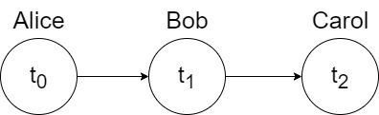
3.2 Structured Probabilistic Models
The problem with the table-based approach is that we are explicitly modeling every possible kind of interaction between every possible subset of variables.
The probability distributions we encounter in real tasks are much simpler than this.
Usually, most variables influence each other only indirectly.
For example, consider modeling the finishing times of a team in a relay race. Suppose the team consists of three runners, Alice, Bob, and Carol.

Slide 22
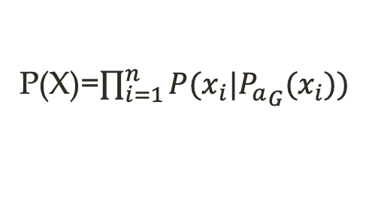
^{3.3 Directed Models}
﻿In general, our estimate of t₁ depends on t₀. Our estimate of t₂ depends directly on t₁ but only indirectly on t₀.
P(t₀, t₁, t₂)=P(t₀)* P(t₀| t₁ ) * P(t₂ | t₁ t₀) = P(t₀)* P(t₀| t₁ ) * P(t₂ | t₁)
﻿In general, ﻿gives the parents of x_{i} in G. The probability distribution over x is given by
P(X)=$\prod_{i=1}^{n}{P(x_{i}|{P_{a}}_{G}(x_{i}))}$

Slide 23
^{3.4 Directed Models}
Does this model work?
﻿Suppose we represented time by discretizing time ranging from minute 0 to minute 10 into 6 second chunks. ﻿This would make t0, t1, and t2 each be discrete variables with 100 possible values.
Unstructured model: ﻿ 999,999 values
Structured model: ﻿ ﻿19,899 values
Since t₀ requires 99 values, ﻿t₁ given t₀ requires 9900 values, ﻿and so does the table defining t₂ and t₁.

Slide 24


